Slide 1
Sudoku-Solver Program
Computer Vision and Image Processing
Abdullah Mahmood AL-Khalidy

Slide 2
Game Definition

Slide 3
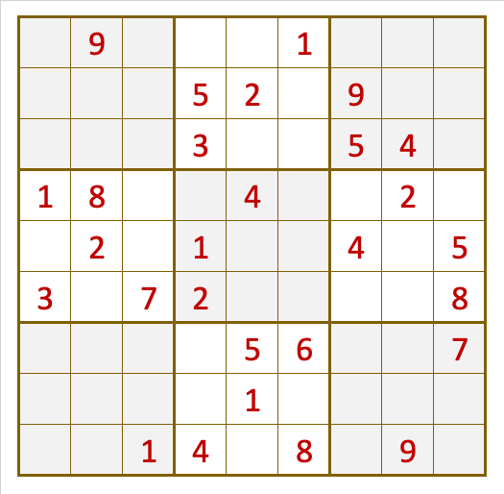

Slide 4
Contents
1.model training mnist 2.image sudoku 3.Sudoku

Slide 5
Used Libraries

Slide 6
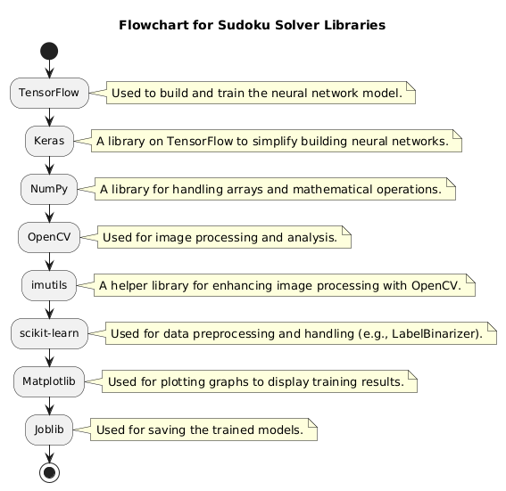

Slide 7
1.model training mnist

Slide 8
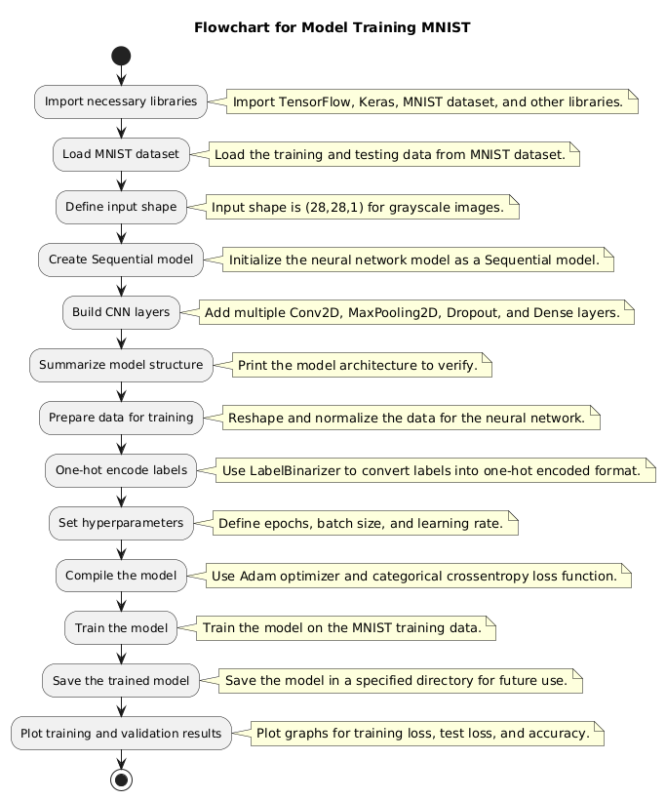

Slide 9
2.image sudoku

Slide 10
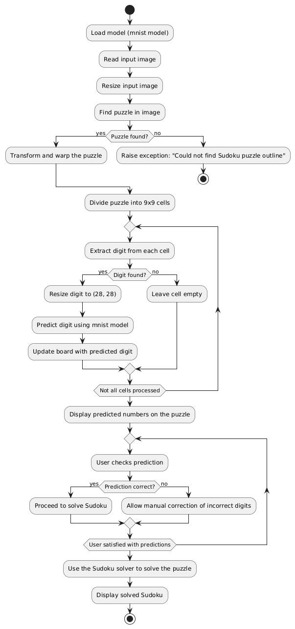

Slide 11
3.Sudoku

Slide 12
